Slide 1
Real-Time Hand-Tracking

Slide 2

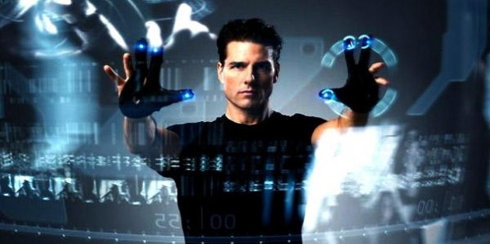

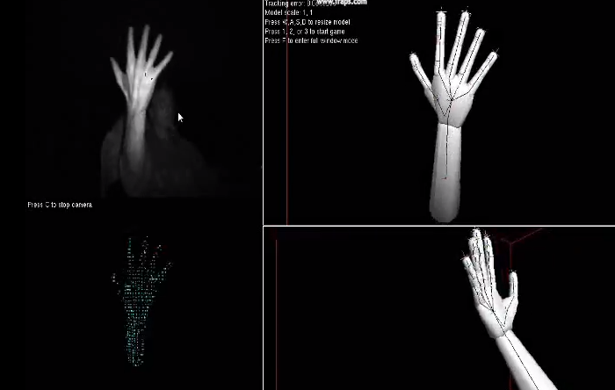
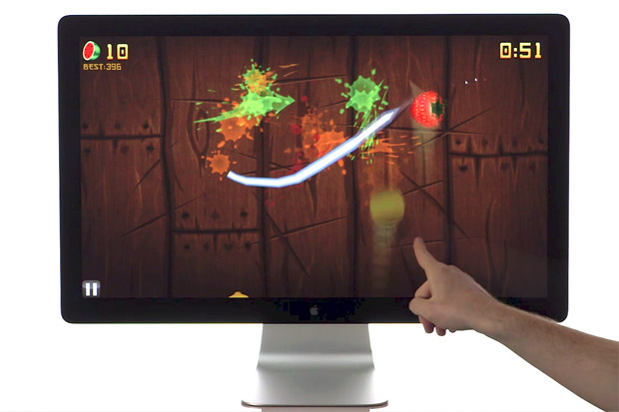
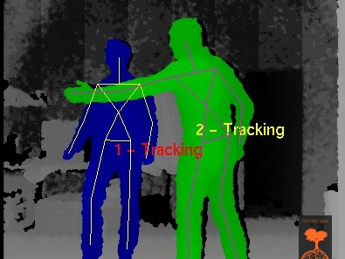
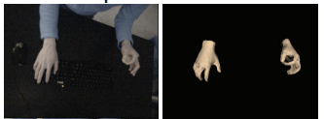
Motivation
Hand / gesture interactions are intuitive
Why not track them as a user interface?
Many attempts:
Melax et. al.
Leap Motion
Kinect
Also, Intel Perceptive Motion SDK, and others
Wang et. al.

Slide 3
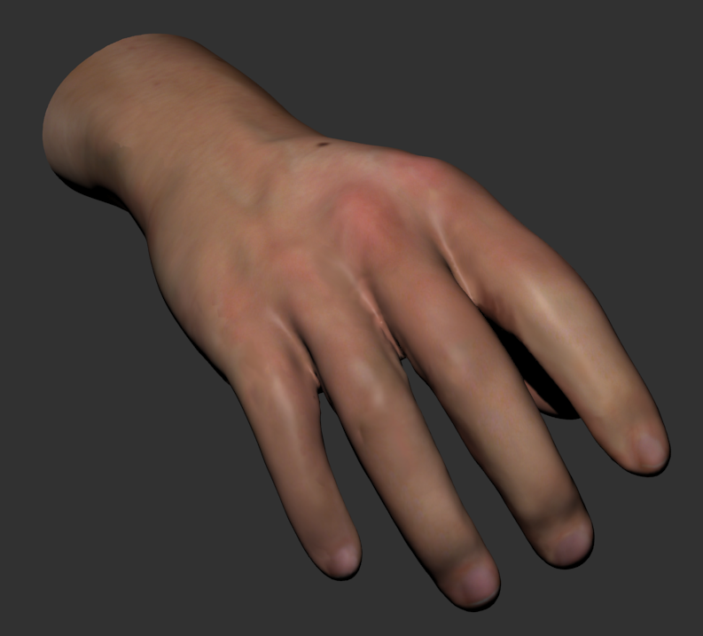
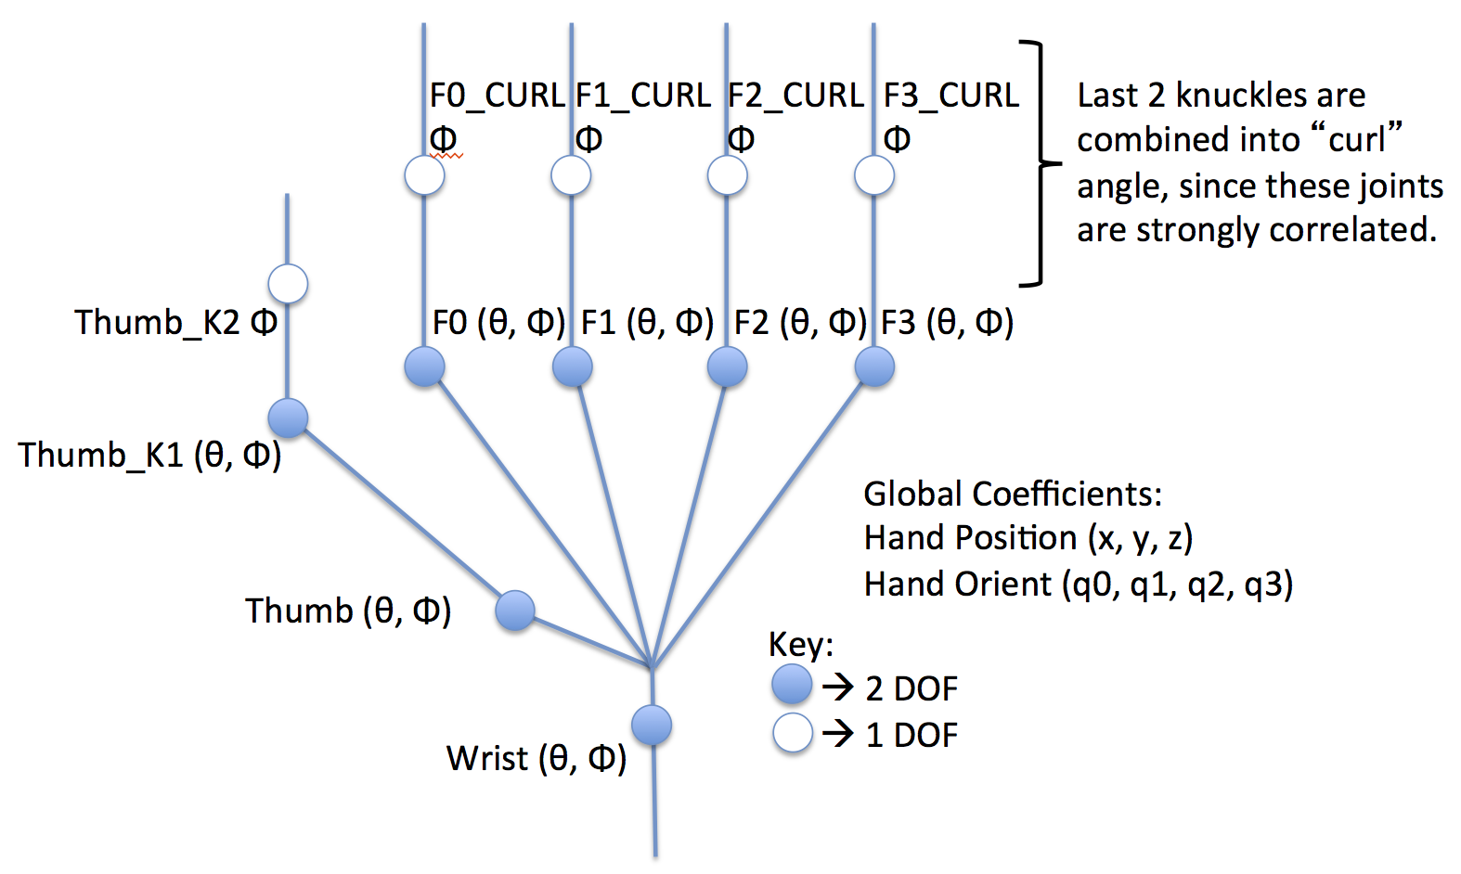
What is the Problem?
Many levels of difficulty:
Track hand position / orientation (Kinect)
Track finger tip position (Leap Motion)
Track hand skeleton and mesh (research / Intel)
Hand has many degrees of freedom (>25)
We want to track all of them!

Slide 4
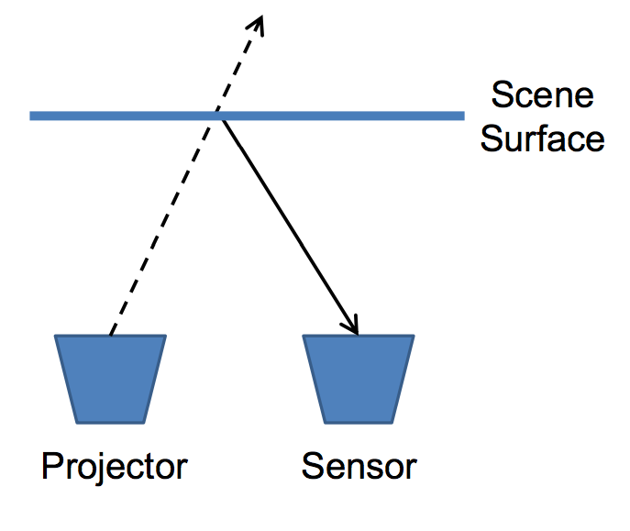
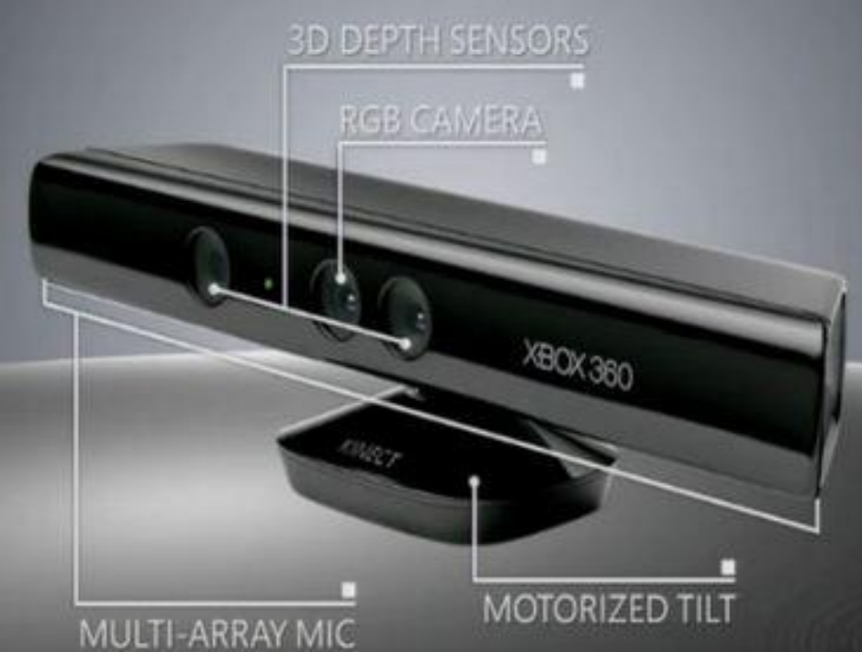
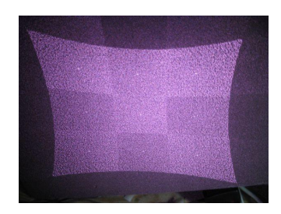
The Kinect
Cheep RGBD camera – Structured Light
Project Known IR Pattern
IR Sensor with parallax to projector: dots shift + spacing grows as objects move away from camera
With math + filtering: depth can be recovered

Slide 5
Our Hand Tracking Approach
Machine learning:
“Create a dataset and learn it”
3 Phases:
Data collection
Training set generation
Learning
Randomized Decision Forest
(hand segmentation)
Record data + image processing
Convolutional Neural Network
(real-time pose)
Offline: fit hand-model using PSO
(pose estimation)

Slide 6
Our Hand Tracking Approach
Machine learning:
“Create a dataset and learn it”
3 Phases:
Data collection
Training set generation
Learning
Randomized Decision Forest
(hand segmentation)
Record data + image processing
Convolutional Neural Network
(real-time pose)
Offline: fit hand-model using PSO
(pose estimation)

Slide 7
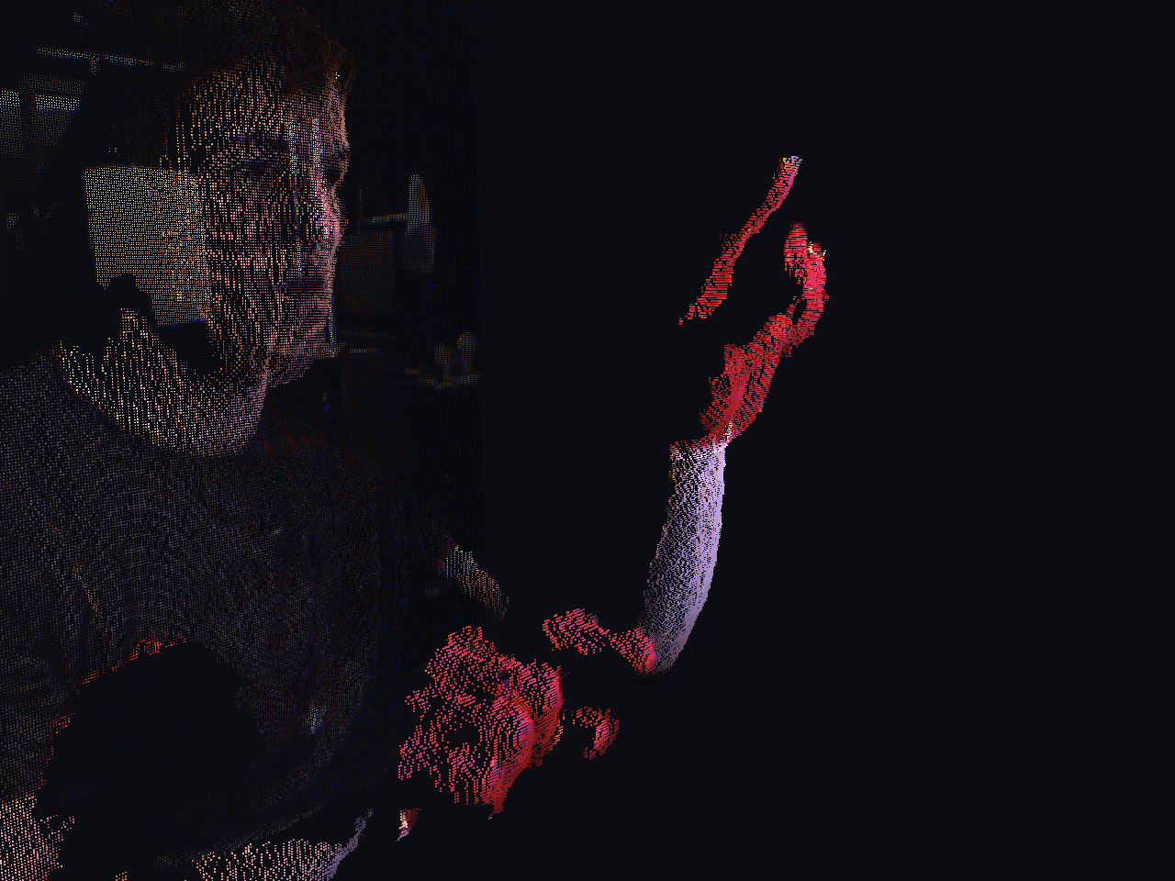
1. Data Collection + Image Segmentation
Paint hands red using body paint
Red shows up well in Kinect HSV
Record 30fps Kinect Stream
Move hands slowly… Temporal coherence!
Segment depth image based on Red pixels
Some hacks, but OK
Data Collection
Record RGBD frames
User hand painted red
Image Segmentation
Image processing to extract hand-pixels

Slide 8
Our Hand Tracking Approach
Machine learning:
“Create a dataset and learn it”
3 Phases:
Data collection
Training set generation
Learning
Randomized Decision Forest
(hand segmentation)
Record data + image processing
Convolutional Neural Network
(real-time pose)
Offline: fit hand-model using PSO
(pose estimation)

Slide 9
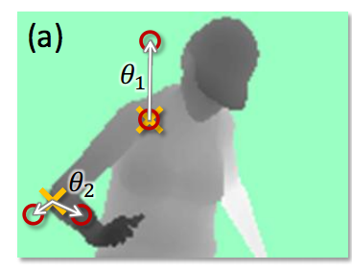
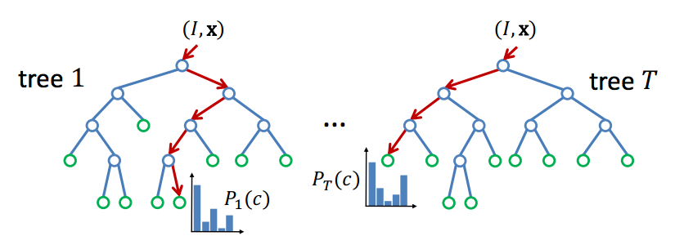
2. Randomized Decision Forest
A forest of simple weak learners, but together make smart decisions
Our approach based on Microsoft’s paper: “Real-Time Human Pose Recognition in Parts from Single Depth Images”
Weak learners compare pixel depths
Boolean comparisons through decision tree
Forest of trees leads to better generalization

Slide 10
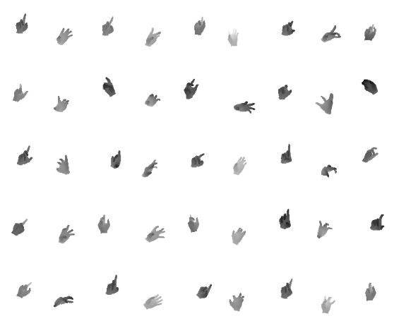
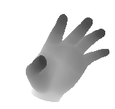
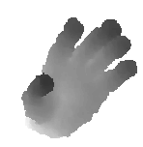
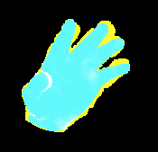
Synthetic Images
Can Render synthetic depth images @ 5000fps
Given a pose guess, we can “compare” the real and synthetic depth data
Synthetic Depth:
Real Depth:
Residual Image:

Slide 11
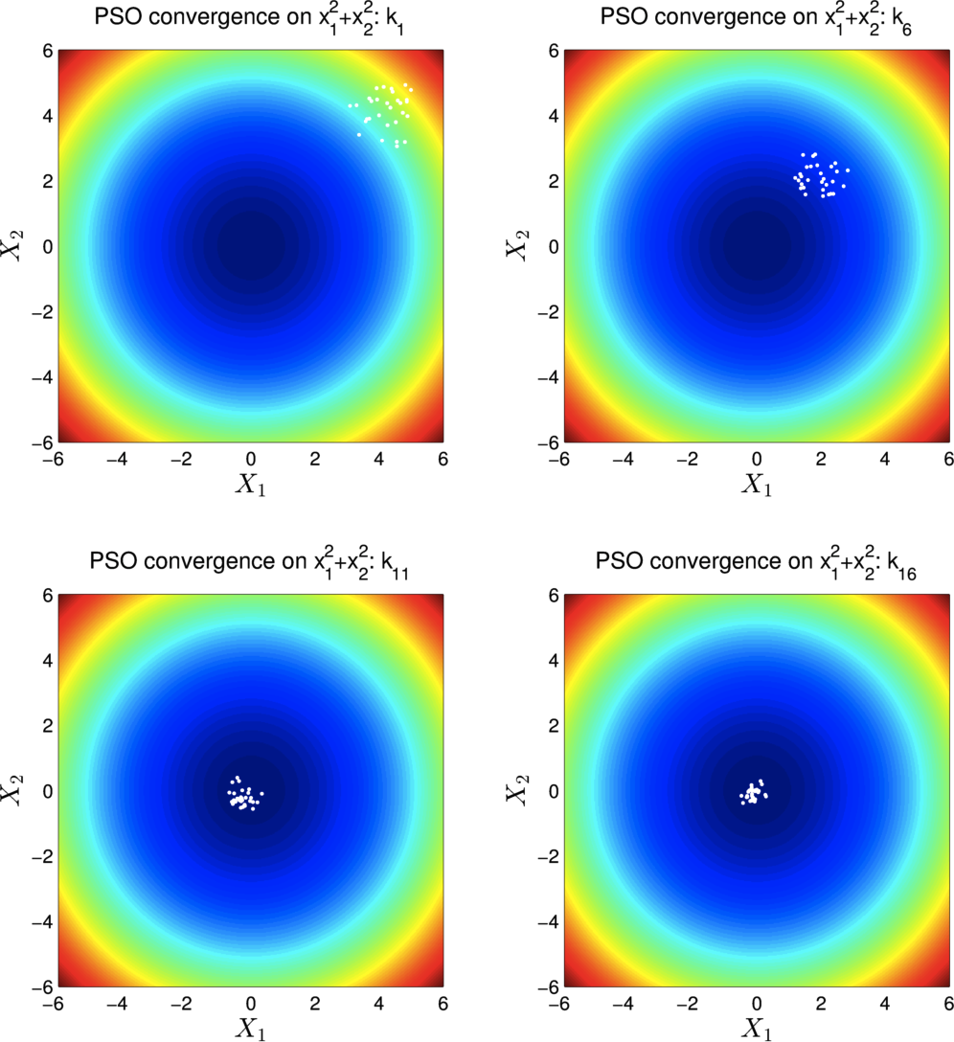
PSO Overview
“Particle swarm optimizer”
Finds minimum of an unconstrained function
Direct search method
No derivatives
Heuristic / Genetic algorithm
Good for multi-modal problems of moderate dimensionality

Slide 12
2. PSO Fitting
Loop:
Render synthetic poses for N particles
Check if result is good enough
Evaluate “goodness” of each particle
Update particles in the swarm based on relative fit
Render Hypothesis
Evaluate Fit
Adjust Hypothesis
Check Termination

Slide 13
Our Hand Tracking Approach
Machine learning:
“Create a dataset and learn it”
3 Phases:
Data collection
Training set generation
Learning
Randomized Decision Forest
(hand segmentation)
Record data + image processing
Convolutional Neural Network
(real-time pose)
Offline: fit hand-model using PSO
(pose estimation)

Slide 14
3. Convnet Architecture
Classic “multi-bank convolutional neural network”
x16
x16
96x96
5x5 conv→16feat
full map
92x92
Tanh,
2x2 L2 pool,
spatial sub. normaliz.
46x46
x64
x64
7x7 conv→128feat
random map fan-in 4
40x40
Tanh,
4x4 L2 pool,
spatial sub. normaliz.
10x10
Bank 1
Bank 2
Fully connected
neural net
Fully connected
neural net
23
vector
Bank 3
256 vector
6400 vector

Slide 15
Convnet Pipeline
Takes in a cropped hand image and outputs 25 floats
We use torch7 (Yann LeCunn et al.) to train convnet
Training is performed on 25k+ training images
~12-24 hours training time using Cuda
Forward model is ~3ms on Cuda in torch

Slide 16
Demo

